Slide 1
Domain Name System
DNS

Slide 2
The Domain Name System (DNS) is a hierarchical decentralized naming system for computers, services, or other resources connected to the Internet or a private network.
By the early 1980s, maintaining a single, centralized host table had become slow and unwieldy and the emerging network required an automated naming system to address technical and personnel issues.
DNS was first described in 1983 and implemented in 1984.
RFC 882/883 – November 1983

Slide 3
FQDN
A domain name is an identification string that represents IP address of a resource.
A fully qualified domain name is a domain name that specifies its exact location in the tree hierarchy of the Domain Name System.
1987 - RFC 1035 (suppressed RFC 882/883 specifications)
”.”
.com
.ua
domain.com
domain.ua

Slide 4


Recursive / Iterative DNS lookup
The question a client asks a dns server is called a query. When a client queries for an IP address, this is called a forward lookup query.
What’s IP address of domain.com?
Here it is / This server may
Iterative

Slide 5




Forward DNS lookup
Root server
2. IP address for domain.com?
3. Ask this TLD
1. IP address for domain.com?
4. IP address for domain.com?
TLD
5. Ask authorative DNS
domain.com
6. IP address for domain.com?
7. It is 123.123.123.123
DNS Resolver
7. It is 123.123.123.123
Authorative DNS
https://www.youtube.com/watch?v=mpQZVYPuDGU

Slide 6

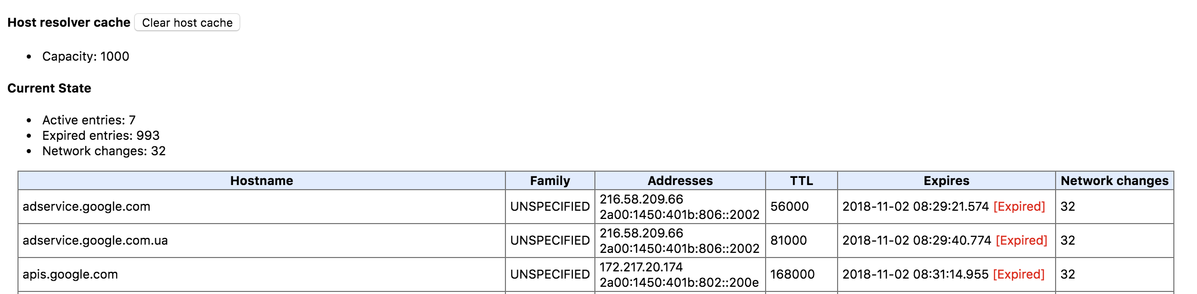
Browser cache
chrome://net-internals/#dns

Slide 7
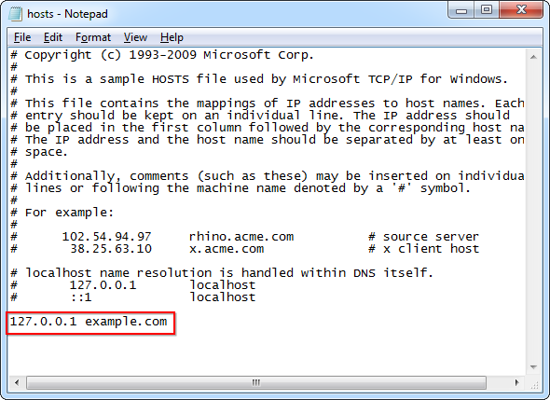
hosts
In the Seventies, only a few hundred computers were connected to the internet. To resolve names, computers had a flat file that contained a table to resolve hostnames to ip addresses. This local file was called hosts.txt and could be downloaded from on an ftp server in Stanford.
This file is still active today on most computer systems under the name /etc/hosts or C:/Windows/System32/Drivers/etc/hosts.

Slide 8
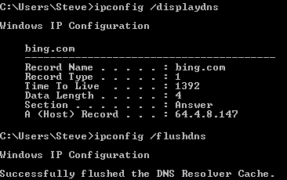
OS Cache

Slide 9
DNS Resolver
The Recursive Resolver is the one that will get queries from a group of clients and ask around the Internet in search of the answers. It is usually a service provided by ISPs and it serves several clients.
This is either provided by a dhcp server or manually entered (in Linux clients keep this information in the /etc/resolv.conf file).
It can store answers in its own cache.

Slide 10
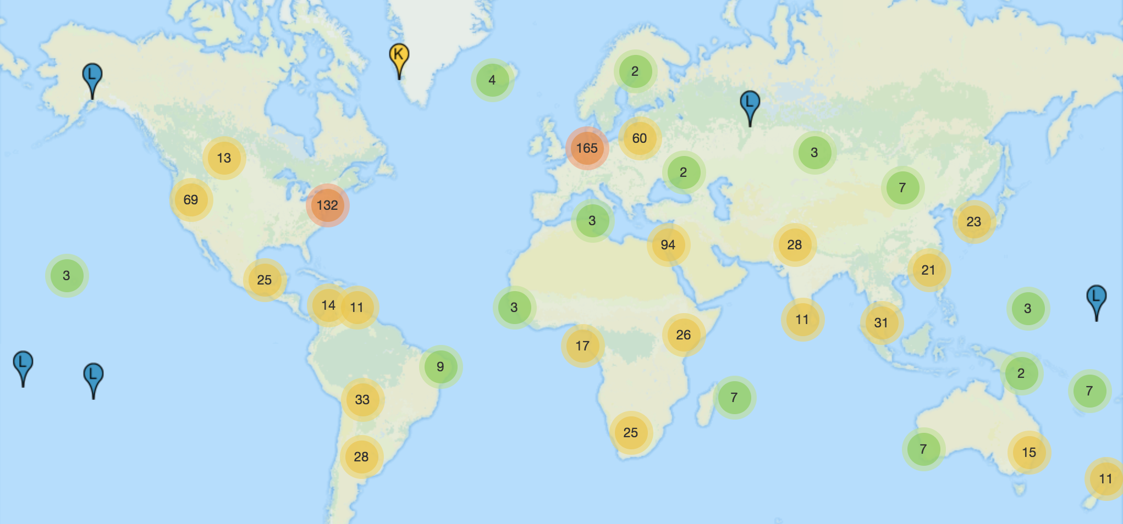
Root hints
There are thirteen root servers on the internet, they are named A to M. (use Anycast)
http://www.internic.net/domain/named.root

Slide 11
Anycast DNS
Anycast is a routing method where one IP is used by many servers. The routers decide to which server to connect based on their routing tables. It will fast connect the user to the chosen server and reduce the latency.

Slide 12
Top Level Domain DNS
Top Level Domain (TLD) is the last part of an FQDN.
TLD DNS knows where to find the nameserver that hosts the zone for the domain under this TLD.
Glue record
It is an association of the hostname (nameserver) with IP address at the registry. It is sent by TLD server in their response to the query when a domain's nameservers is set to a hostname that is a subdomain of the domain itself.
https://www.youtube.com/watch?v=Rck3BALhI5c

Slide 13
Authoritative DNS
DNS server that is controlling a zone for a domain name.
Host
DNS Class
DNS Record type
Value

Slide 14
DNS records
A - contains IPv4 address of a server
AAAA - contains IPv6 address of a server
MX - points to an SMTP server
CNAME - maps a hostname to a hostname, creating effectively an alias for an existing hostname
SOA - contains meta information about the zone itself
https://www.youtube.com/watch?v=6uEwzkfViSM

Slide 15
SOA (Start of Authority)
Serial – serial number for the zone.
Refresh - number of seconds after which secondary name servers should query the master for the SOA record, to detect zone changes
Retry - number of seconds after which secondary name servers should retry to request the serial number from the master if the master does not respond.
Expire - number of seconds after which secondary name servers should stop answering request for this zone if the master does not respond
TTL (Time To Live) – number of seconds for which the DNS data is considered up-to-date.

Slide 16
BIND (Berkeley Internet Name Daemon)
de facto standard DNS server on Unix-like systems.
It performs both of the main DNS server roles:
authoritative name server for one or more specific domains,
recursive resolver for the DNS system generally.
Designed at the University of California, Berkeley (UCB) in the early 1980s.

Slide 17
Unbound
Unbound is a validating, recursive, and caching DNS resolver product from NLnet Labs.
It is smaller, more modern, and more secure for most applications.
Cannot be used as an authorative nameserver.
Used for resolving other CDN cache nodes and origin in Ericsson UDN.

Slide 18
Reverse DNS lookup
Reverse DNS lookups for IPv4 addresses use the special domain in-addr.arpa (IPv6 addresses use the ip6.arpa domain).
Within that domain are subdomains for each network, based on network number. For consistency and natural groupings, the four octets of the number are reversed.

Slide 19
PTR record
192.168.0.1 - hostname.example.com
Zone for 0.168.192.in-addr.arpa
Type: PTR Host: 1 Points to: hostname.example.com

Slide 20
dnsutils
nslookup – tool for querying DNS servers. Internet Systems Consortium planned to deprecate it in favor of dig, however, this decision was reversed.
dig – Domain Information Groper:
+trace - trace delegation down from root
+x - reverse lookup
dig [@global-server] domain [q-type] [q-class]

Slide 21
EDNS
A specification for expanding the size of several parameters available in the basic DNS protocol that prevented the support of some desirable features.
First published in 1999 - RFC 2671
Since no new flags could be added in the DNS header, EDNS adds information to DNS messages in the form of pseudo-Resource Records ("pseudo-RR"s) included in the "additional data" section of a DNS message.
is essential for the implementation of DNSSec;
used for sending general information from resolvers to name servers about clients' geographic location in the form of the EDNS Client Subnet option (Authoritative Nameservers then use the ECS as a hint to the end user’s network location and provide a geographically-aware answer).

